Slide 1
Voter Registration 1867
6n
Needham and Crawford Bass

Slide 2
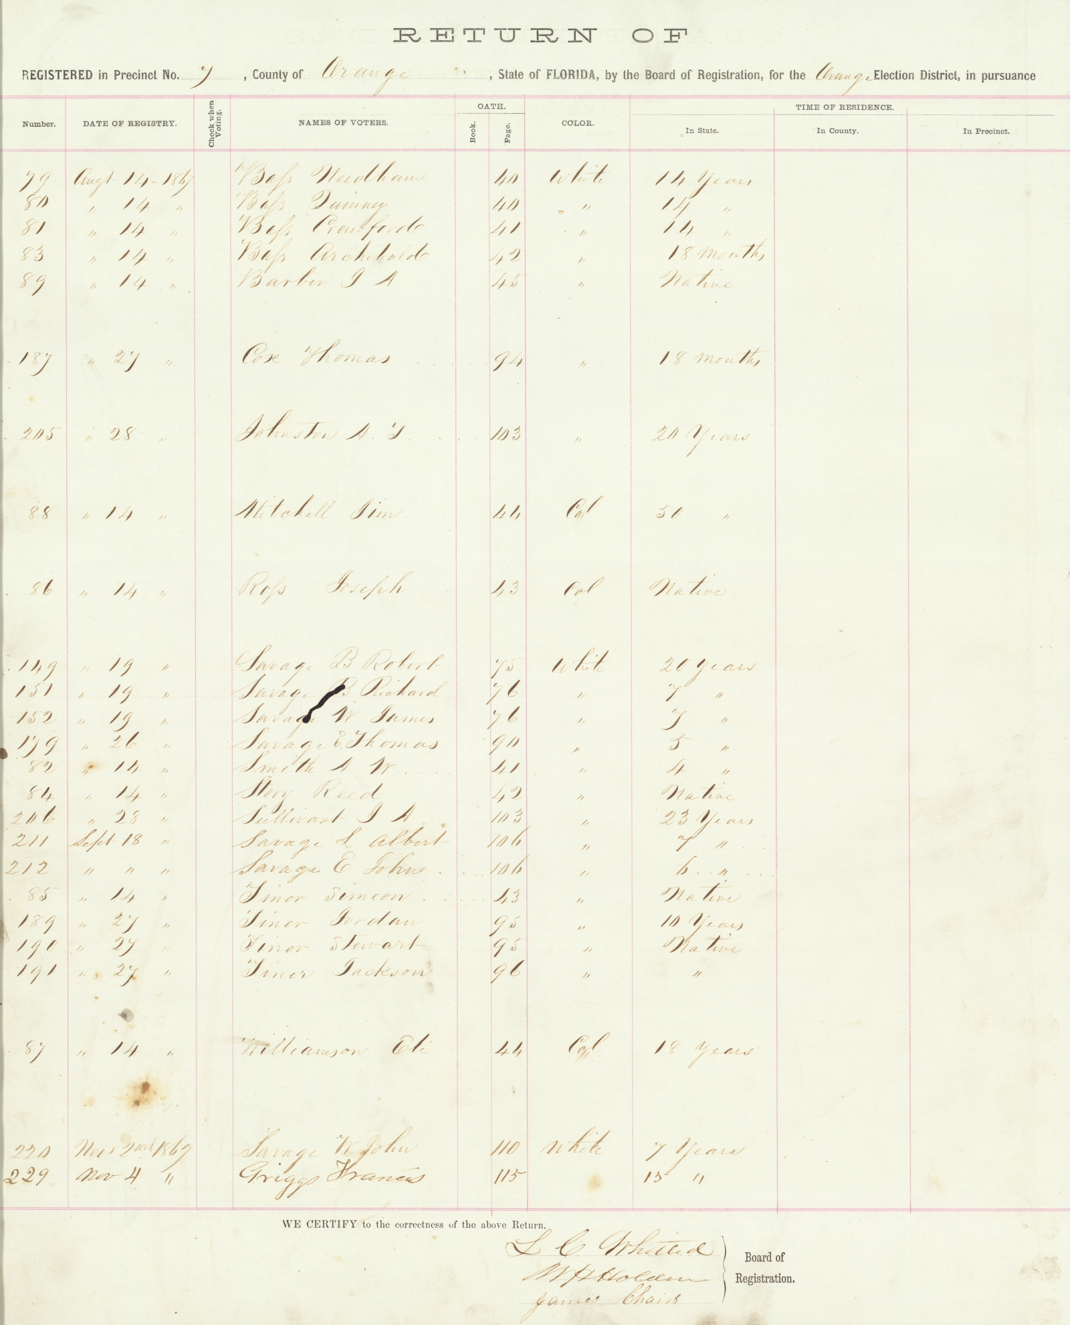
Voter Registration / Orange County, Florida / 1867

Slide 3
Voter Registration / Orange County, Florida / 1867
Needham Bass
Quincy Bass
Crawford Bass
Archibald Bass

Slide 4
Voter Registration / Orange County, Florida / 1867
Needham Bass
Quincy Bass
Crawford Bass
Archibald Bass

Slide 5
Voter Registration / Orange County, Florida / 1867
DATE OF REGISTRY
August 14, 1867
TIME OF RESIDENCE
In State - 14 years In County - In Precinct -
BOARD OF REGISTERS
L. C. Whitted W. H. Holden James Chairs
NAME
Bass, Needham / Crawford Bass
COUNTY
Orange County (Fla.)
RACE
White
VOTER NUMBER
79 / 81
PRECINCT
7

